Slide 1
Setting up your Sequencing reaction
Ameer Effat M. Elfarash
Dept. of Genetics
Fac. of Agriculture, Assiut Univ.
amir_effat@yahoo.com

Slide 2
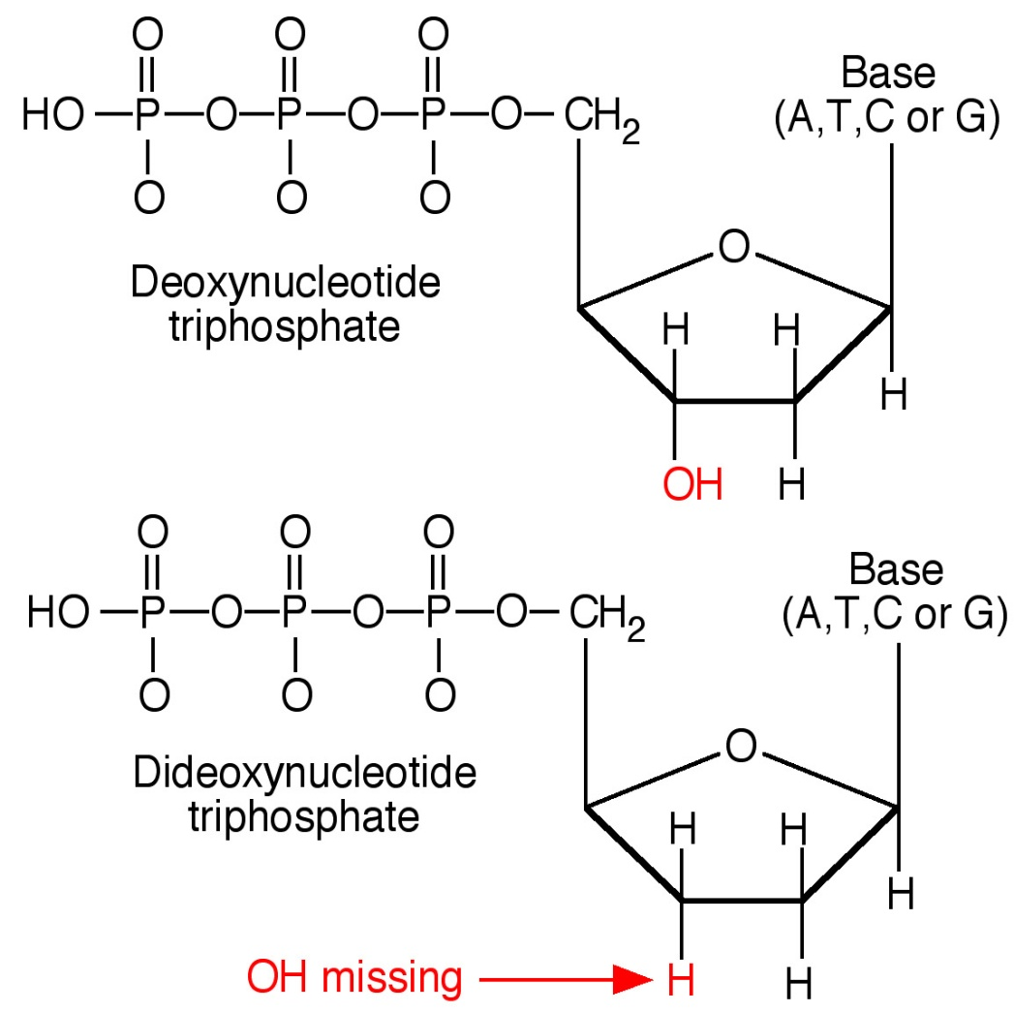
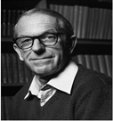
The Sanger method
Uses dideoxy nucleotides to terminate DNA synthesis.
Because they lack the –OH, replication stops

Slide 3
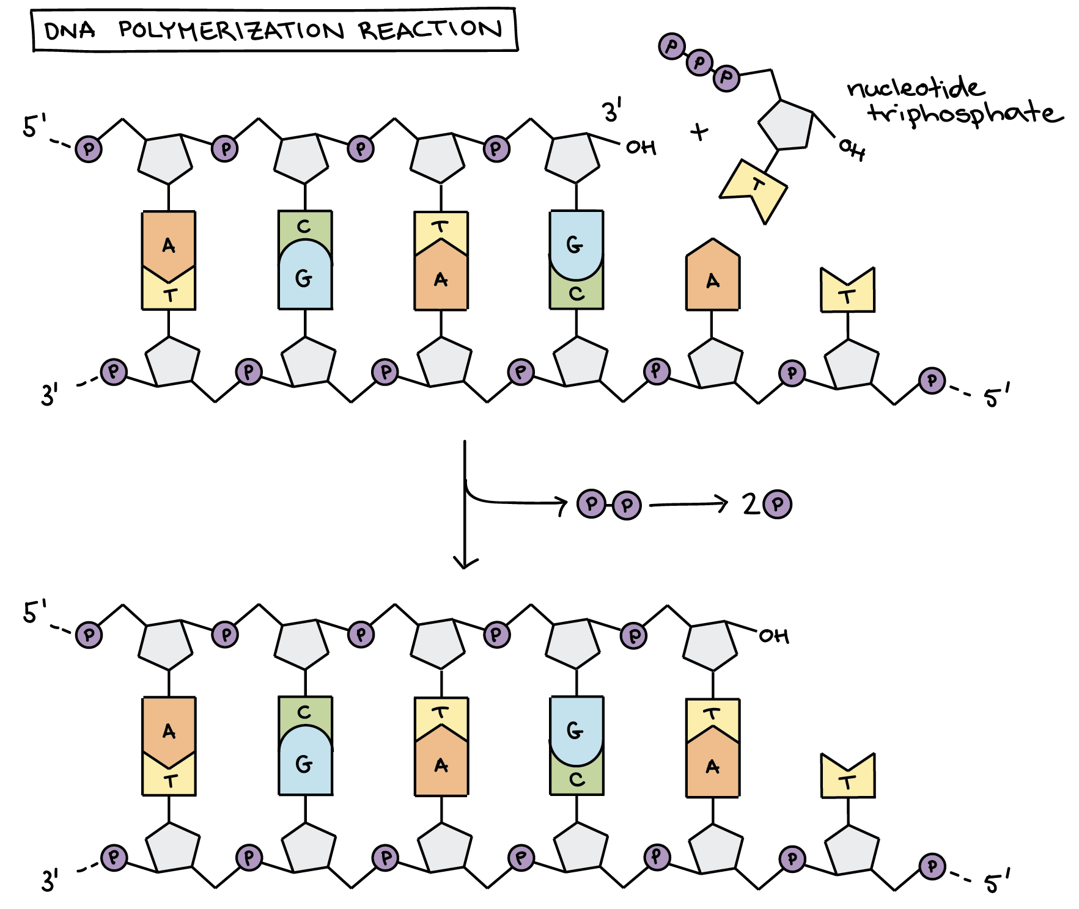

Slide 4
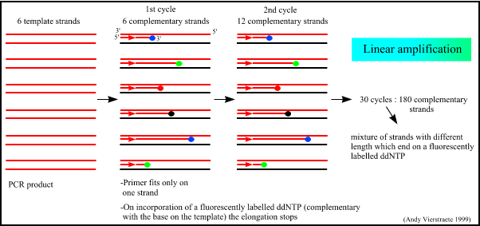

Slide 5
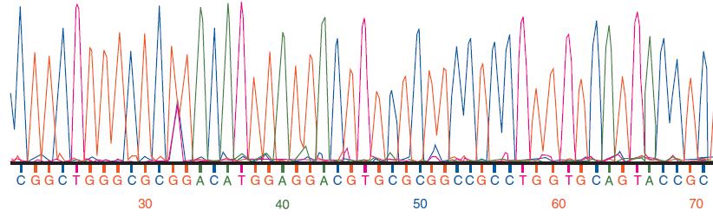
Capillary/ies
Laser
CCD Camera
Buffer

Slide 6
Fluorescent Signal Detection
-
Electrophoresis
CCD
:
Laser
Energy
dye
+

Slide 7
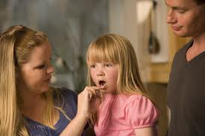
How do we go from this . . .
. . . To this?

Slide 8
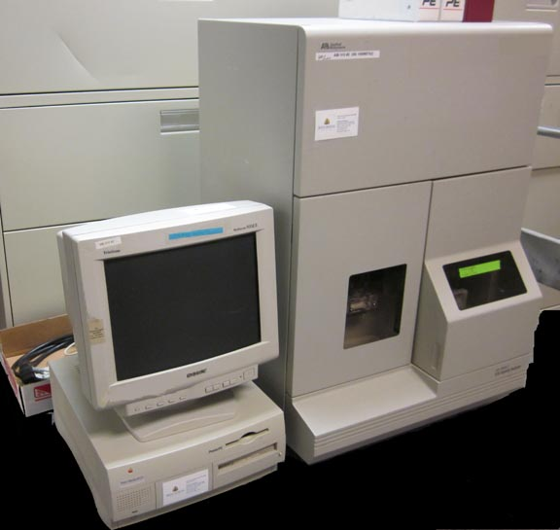
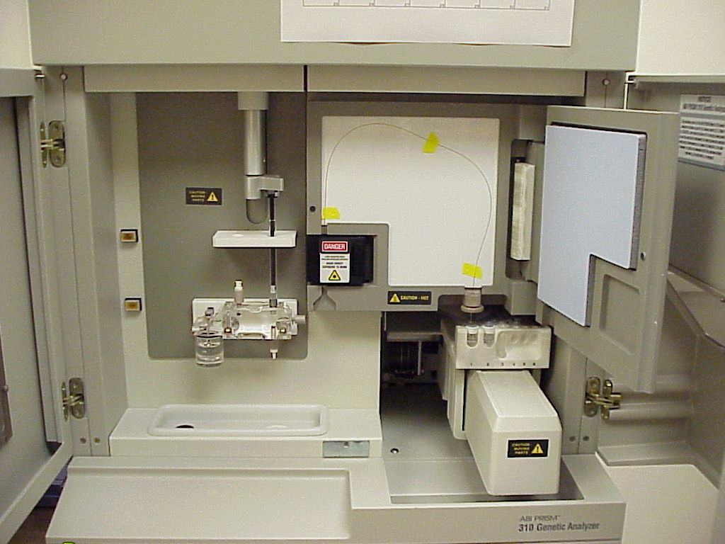
What to do before Loading the Reaction on the sequencer

Slide 9
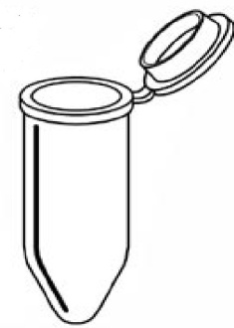
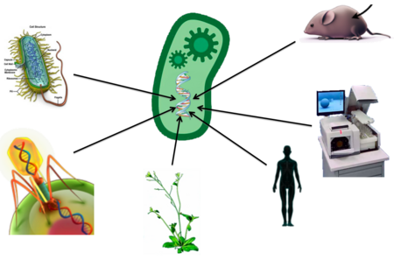
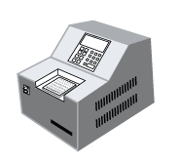




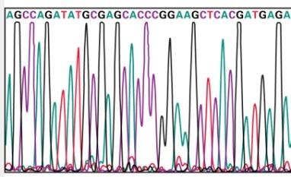
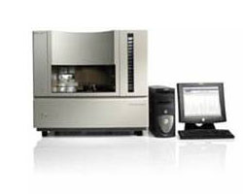
1. DNA isolation
2. PCR amplification of the target gene
4. Set up and Perform sequencing reaction
3. Purify PCR product
5. Purification PCR product
7. Read order of terminators (DNA sequence)
6. Resolve sequence fragments

Slide 10
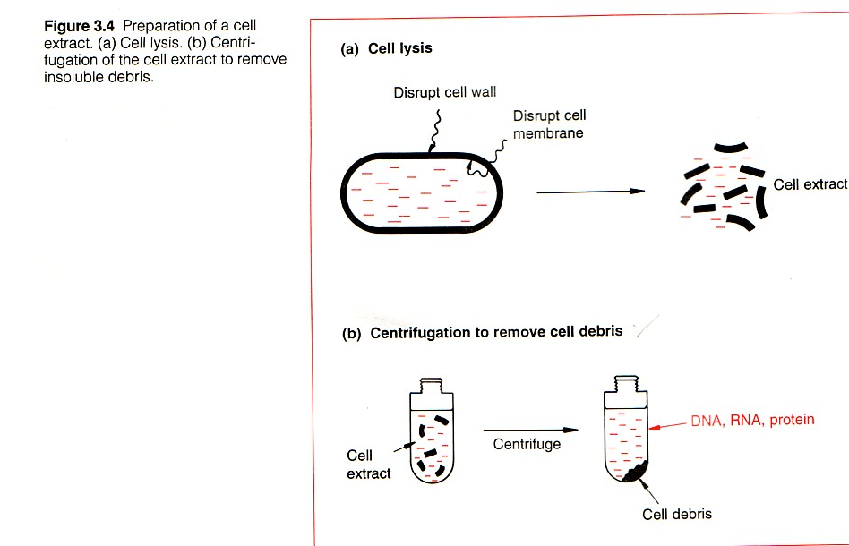
DNA Purification Overview
Most DNA extraction protocols consist of 3 parts
    Cell lysis
    Removing contaminating proteins, RNA, or macromolecules
    Recovery of the DNA

Slide 11
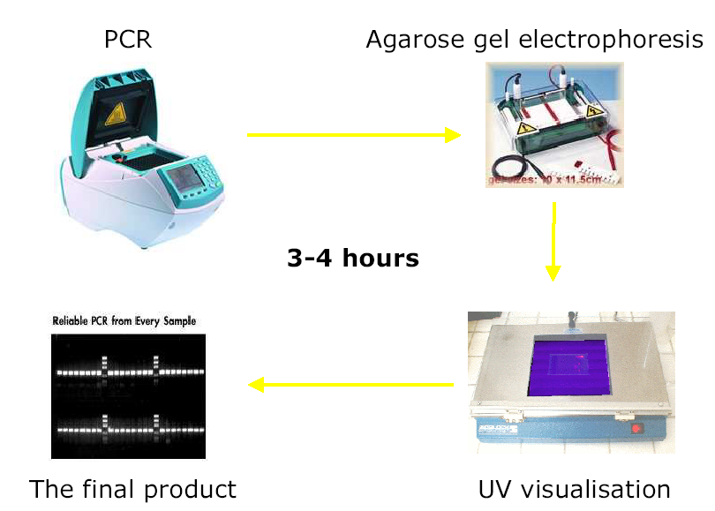
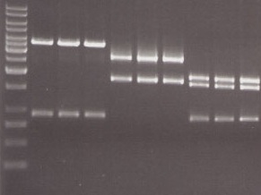
Amplify the target Gene Using (PCR)

Slide 12
Did your PCR work?

Slide 13
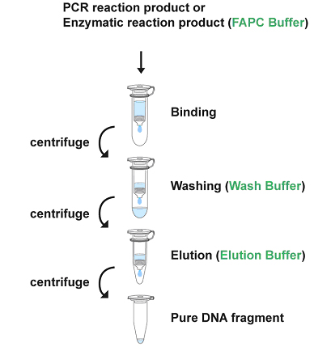
PCR purification

Slide 14
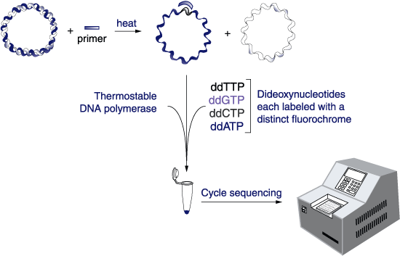
Preparation of Sequencing Reaction

Slide 15
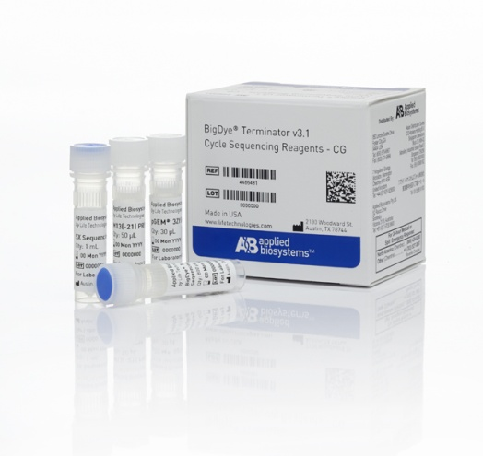
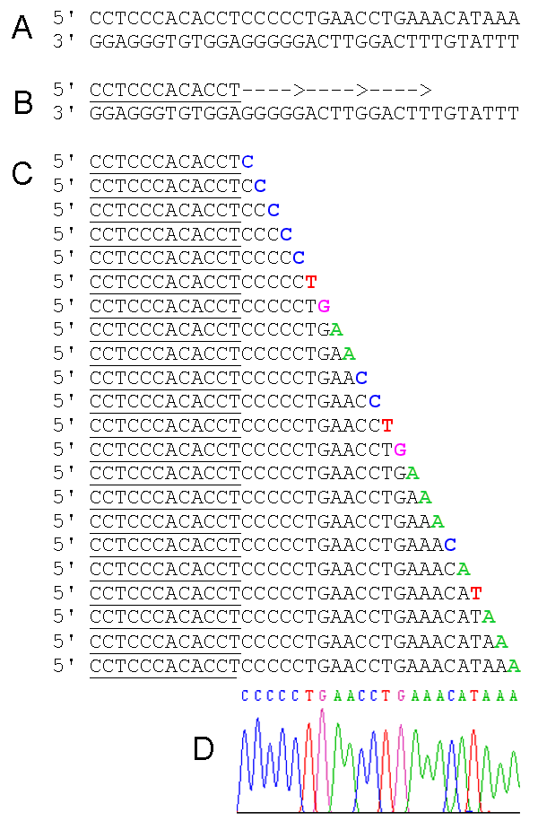
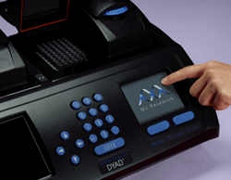
Big-dye sequencing kit (Applied Biosystems)
  20 µl reaction:
    4 .0 µl BigDye Terminator
    2 .0 µl Sequencing buffer
    3.2 µl Primer
    ??? µl Purified DNA
    ??? µl Deionized water
  Program:
    96 °C 1 min
    96 °C 10 sec
    50 °C 5 sec 25X
    60 °C 4 min

Slide 16
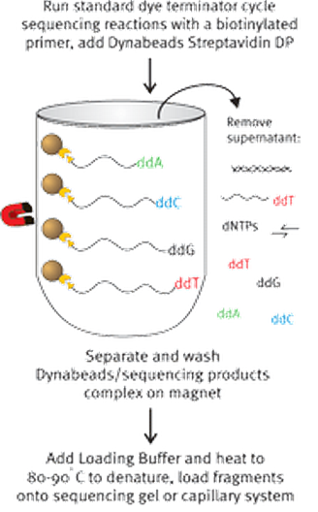
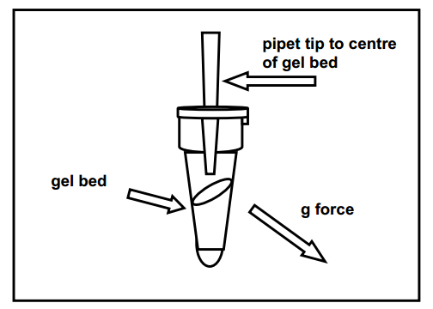

Sequencing Reaction Purification
Centri - Sep Protocol
Elution with Formamide

Slide 17
Loading the Reaction on the
310 ABI sequencer
Accuracy is approx 99%

Slide 18
Instruments 310 / Capillary electrophoresis

Slide 19
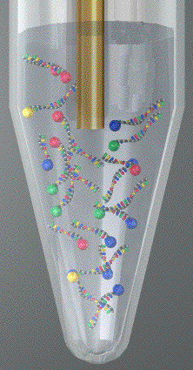
Capillary/ies
Laser
CCD Camera
Buffer
Electrode
(Cathode)
Negatively-charged DNA enters the
capillary as it migrates toward the
postively-charged electrode (anode)
at the other end of the capillary
Capillary

Slide 20
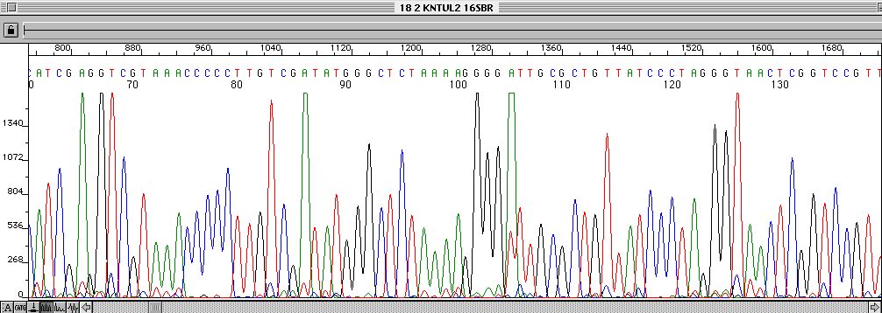
Data output
Data in electropherogram format shows peaks .abi file
Free software sequence scanner v1.0 (Life Tech).
Data in sequence file format shows text .seq file

Slide 21
Factors Influencing PCR Success
Contamination
Cycle parameters
Primers

Slide 22
Avoiding Contamination
  Sample preparation, reaction mixture assemblage should be performed in separate areas.
  A Laminar Flow Cabinet with a UV lamp is recommended for preparing the reaction mixture.
  New gloves should be used for DNA/RNA purification.
  The use of tips with filters for both sample and reaction mixture preparation
  Autoclaving of all buffers is recommended.

Slide 23
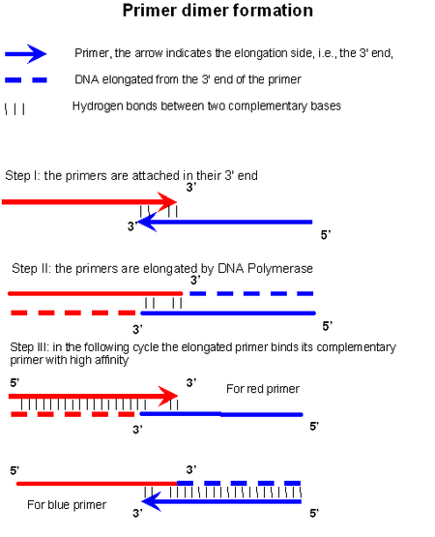
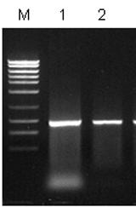
Primers
- The primer should not be self-complementary or complementary to any other primer in the reaction mixture, to prevent primer-dimers.
Primer-dimers interferes with Sequencing

Slide 24
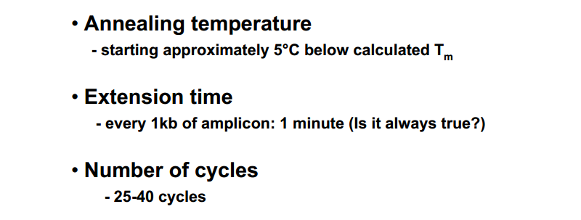
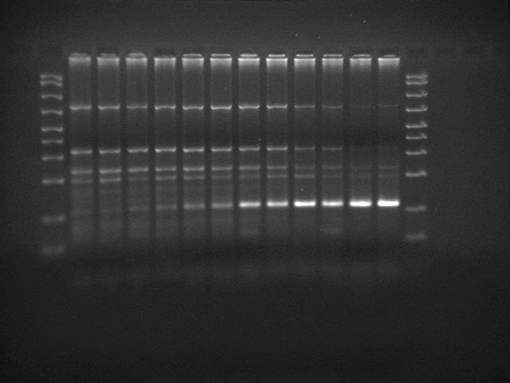
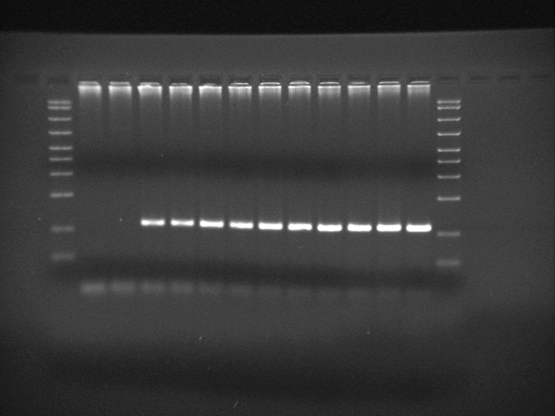
Cycle parameters
Not optimized
Well optimized

Slide 25
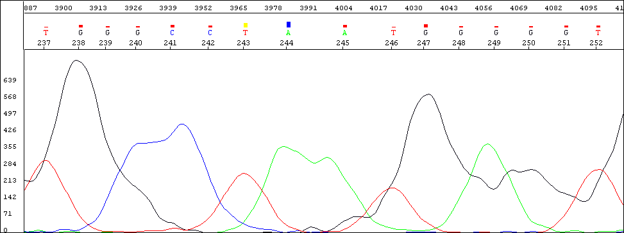
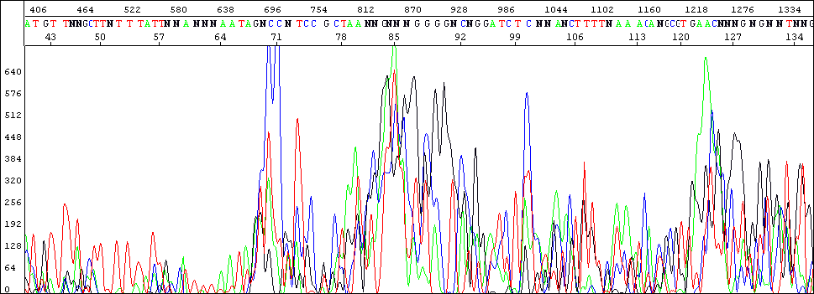
Troubleshooting
Contaminants such as excess salt, RNA or protein in your sample:
These cause the bands to be distorted and wide and the quality scores are low.
The software has problems calling the right bases.
A failed reaction:
There are many Ns called as the reaction has failed due to template and/or primer problems with high background noise observed.
The software cannot call the correct bases.

Slide 26


Slide 27

DNA Sequencing

