Slide 1
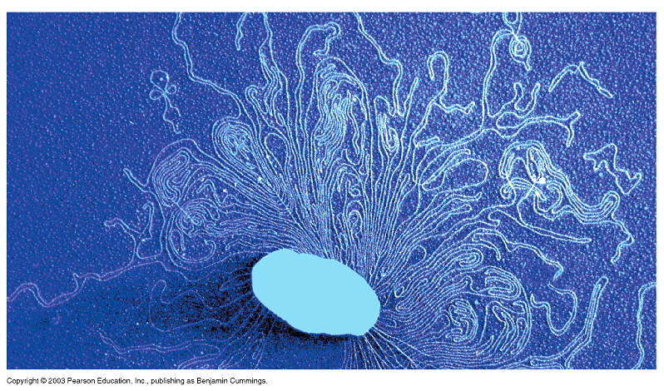
Cloning Vectors
Ameer Effat M. Elfarash
Dept. of Genetics
Fac. of Agriculture, Assiut Univ.
aelfarash@aun.edu.eg

Slide 2
CLONING VECTORS
Cloning vectors are DNA molecules that are used to "transport" cloned sequences between biological hosts and the test tube.
Cloning vectors share four common properties:
1. Ability to replicate.
2. Contain a genetic marker for selection.
3. Unique restriction sites to facilitate cloning of insert DNA.
4. Minimum amount of nonessential DNA to optimize cloning.

Slide 3
Types of vectors
Different types of cloning vectors are used for different types of cloning experiments.
The vector is chosen according to the size and type of DNA to be cloned
Maximum insert size
(kilobases or kb [1000bp])
Bacterial plasmid
bacteriophage
Cosmids
yeast artificial chromosome
6-12
25
35
200-1000

Slide 4
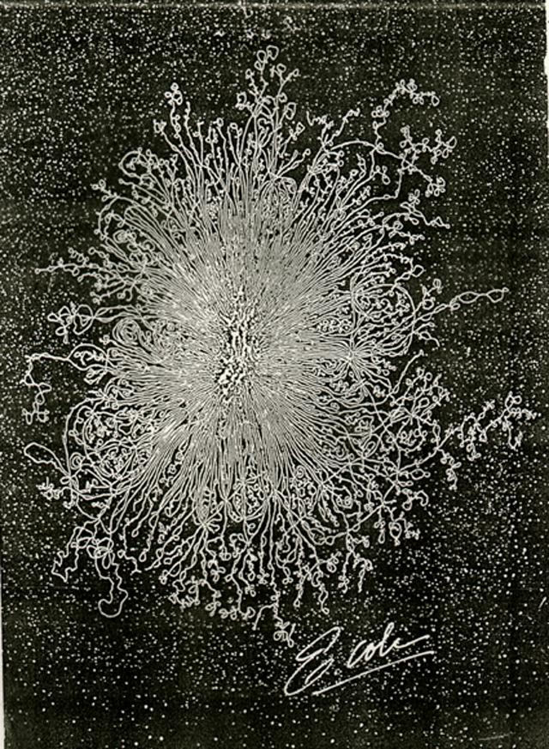
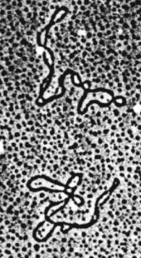

Bacterial plasmids
Most bacterial DNA is on a single large chromosome, but some DNA is in a small circle called a plasmid.

Slide 5
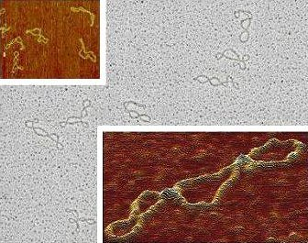
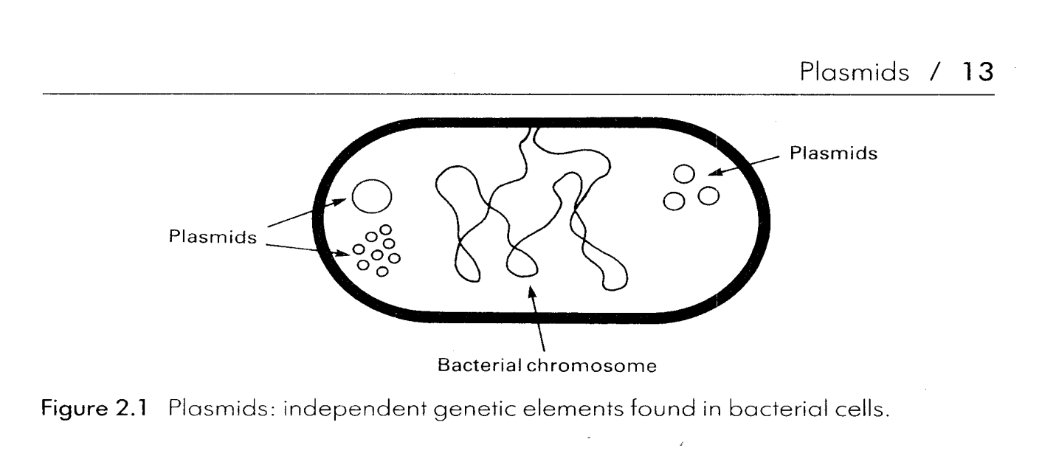
Bacterial Plasmids in Nature
Occur naturally in bacteria and usually carry genes that are useful but not essential to survival
There can be as many as several hundred copies of a single plasmid in each bacteria.
They can replicate independently of the host cell.

Slide 6
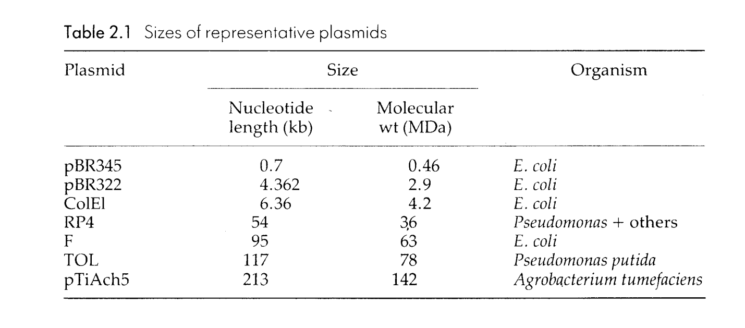
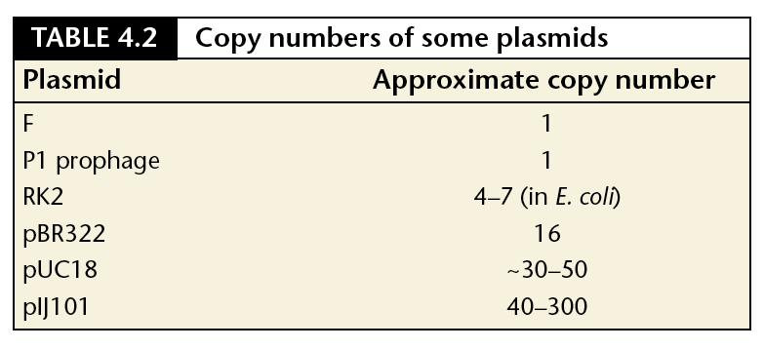
Size and copy number

Slide 7
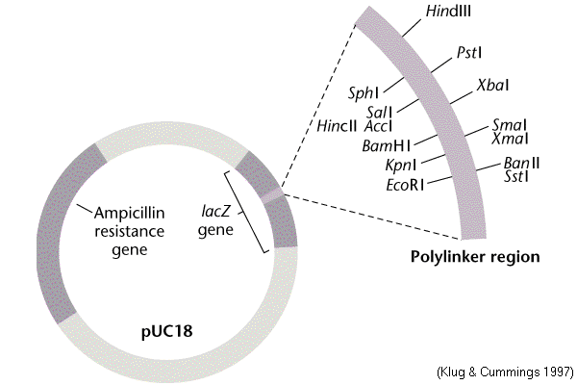
PLASMID VECTORS
Plasmid vectors are used to clone DNA ranging in size from several base pairs to several thousands of base pairs (100bp -10kb).
Most vectors are genetically engineered.
Features of many modern Plasmids
Small size
Origin of replication
Multiple cloning site (MCS)
Selectable marker genes
Expression vectors have sequences that allow RNA polymerase to transcribe genes

Slide 8
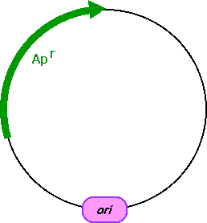
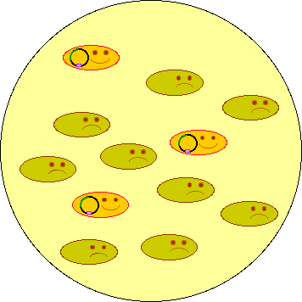
SELECTIVE MARKER
Growing Culture
Spread transformed bacterial cells on the LB plate with selection drug and grow overnight.

Slide 9
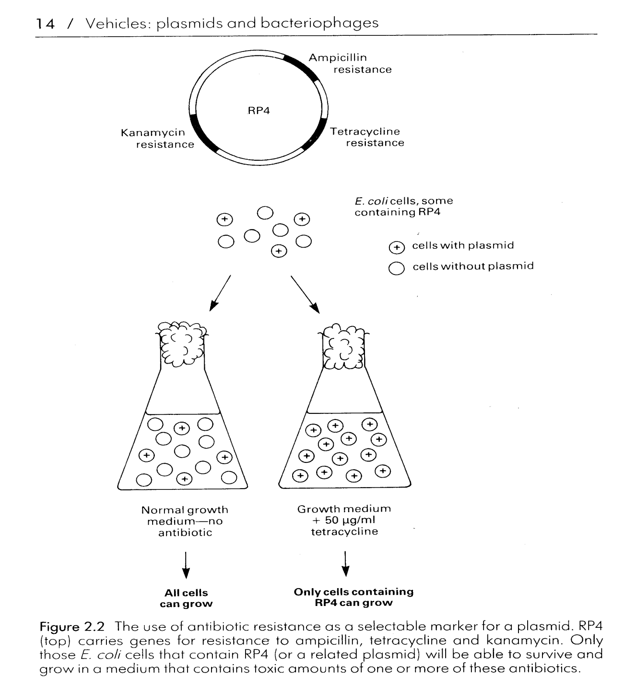
SELECTIVE MARKER

Slide 10
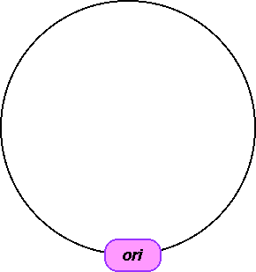
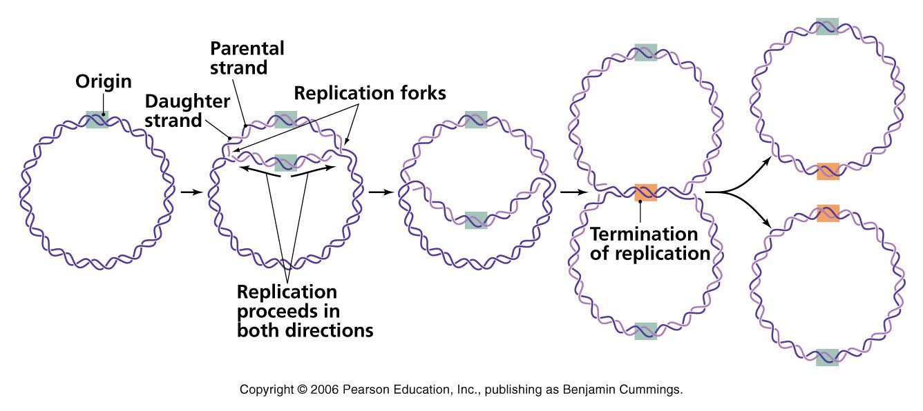
ORIGIN OF REPLICATION
Origin of replication is a DNA segment recognized by the cellular DNA-replication enzymes.
Without replication origin, DNA cannot be replicated in the cell.

Slide 11
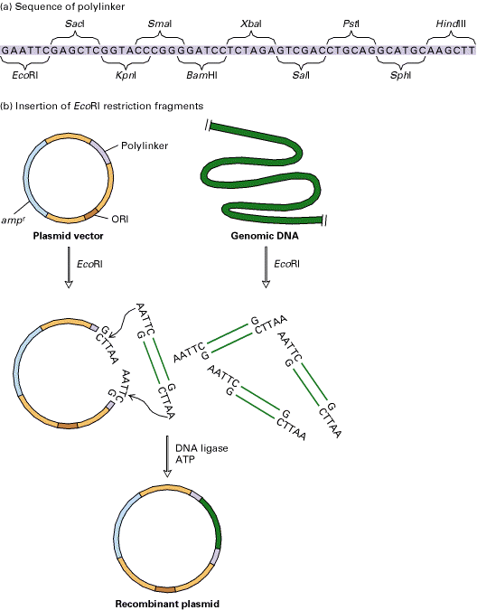
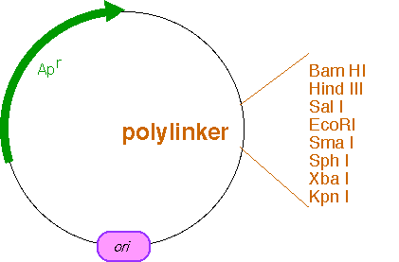
MULTIPLE CLONING SITE
Many cloning vectors contain a multiple cloning site or polylinker: a DNA segment with several unique sites for restriction endo- nucleases located next to each other
Restriction sites of the polylinker are not present anywhere else in the plasmid.
Cutting plasmids with one of the restriction enzymes that recognize a site in the polylinker does not disrupt any of the essential features of the vector

Slide 12
ori
amp^{R}
RNA polymerase promoter sequences
lacZ gene
MCS

Slide 13
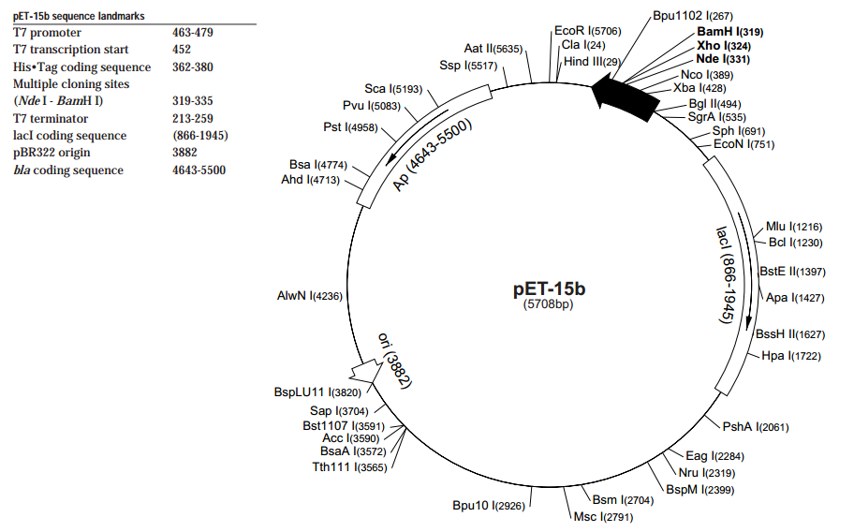

Slide 14
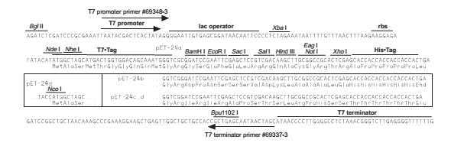

Slide 15
Plasmid Isolation from Bacteria
تنميه المزرعة البكتيرية المحتوية على البلازميد
تحضير المستخلص الخلوى من هذة الخلايا (Cell extract)
التخلص من البروتينات وازالة الـ RNA.
فصل DNA البلازميد عن الـ DNA الكرموسومي الموجودة ايضا فى الخلايا.

Slide 16
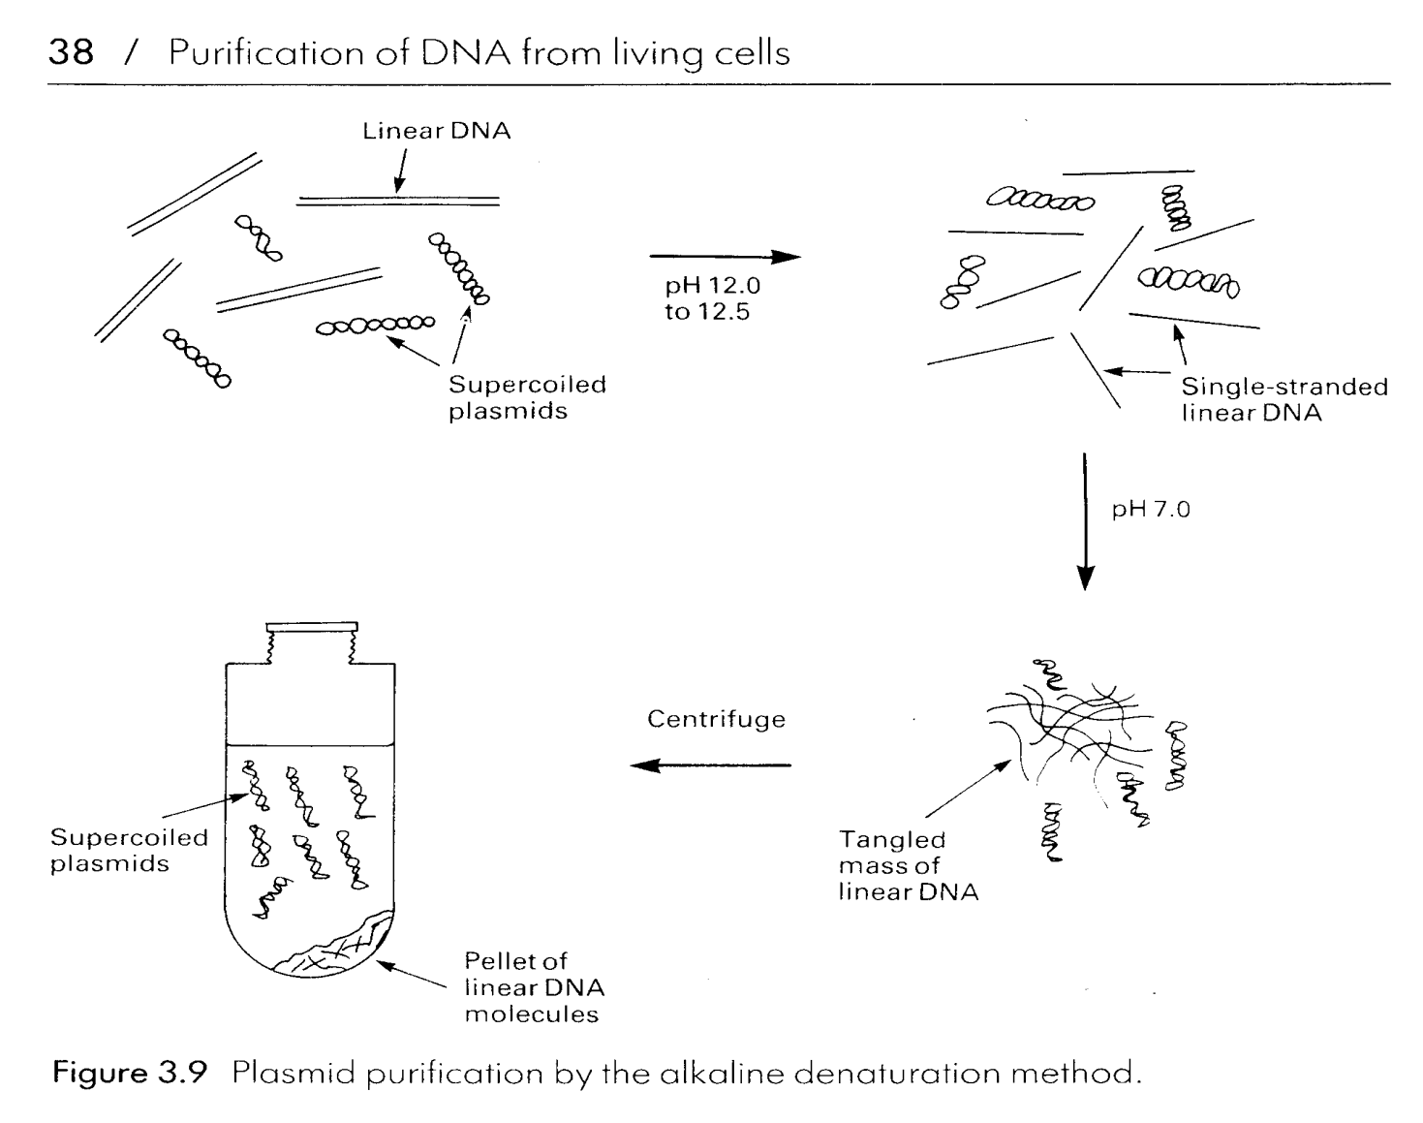
Plasmid Isolation from Bacteria Alkaline denaturation

Slide 17
OTHER TYPES OF CLONING VECTORS

Slide 18
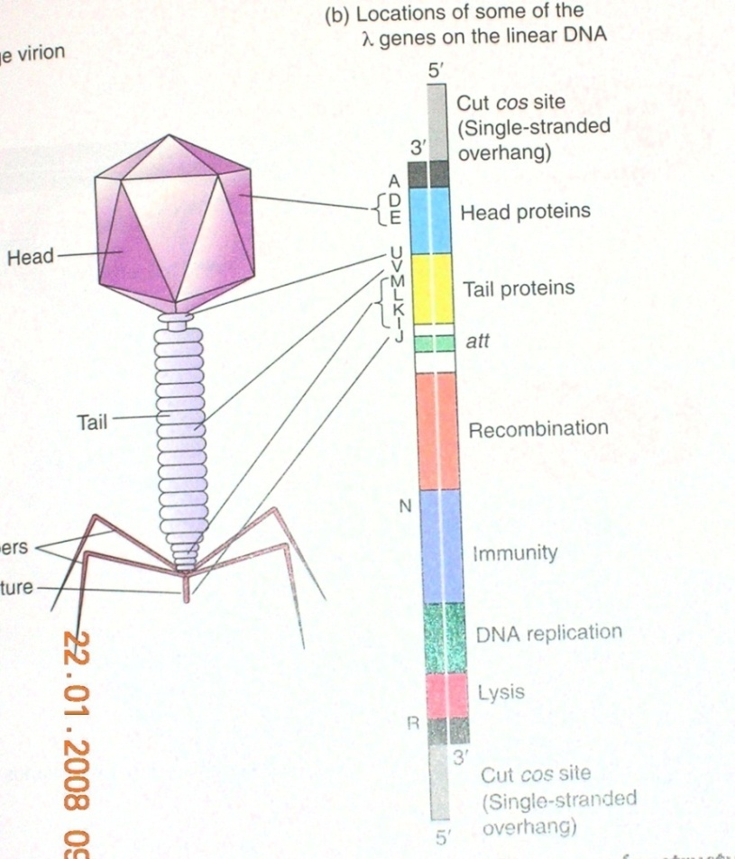
BACTERIOPHAGE LAMBDA
Phage lambda is a bacteriophage or phage, i.e. bacterial virus, that uses E. coli as host.
Its structure is that of a typical phage: head, tail, tail fibres.
Lambda viral genome: 48.5 kb linear DNA with a 12 base ssDNA "sticky end" at both ends; these ends are complementary in sequence and can hybridize to each other (this is the cos site: cohesive ends).
Infection: lambda tail fibres adsorb to a cell surface receptor, the tail contracts, and the DNA is injected.
The DNA circularizes at the cos site, and lambda begins its life cycle in the E. coli host.

Slide 19
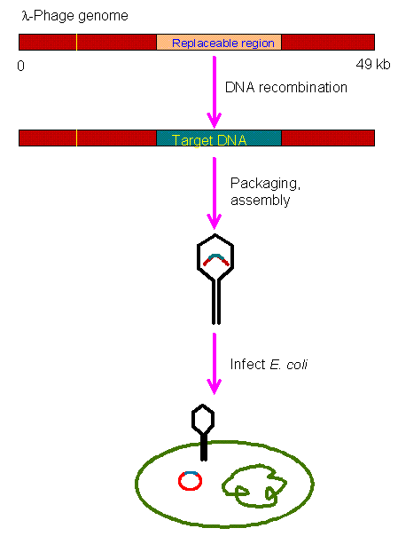

BACTERIOPHAGE LAMBDA

Slide 20
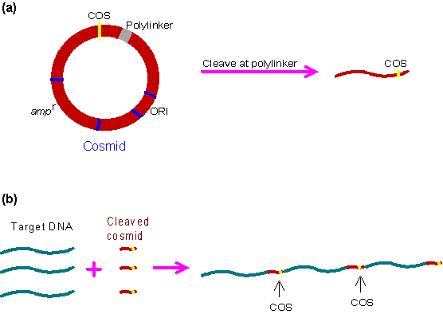
COSMID VECTOR
The cosmid vector is a combination of the plasmid vector and the COS site which allows the target DNA to be inserted into the λ head. It has the following advantages:
  High transformation efficiency.
  The cosmid vector can carry up to 45 kb whereas plasmid and λ phage vectors are limited to 25 kb.

Slide 21
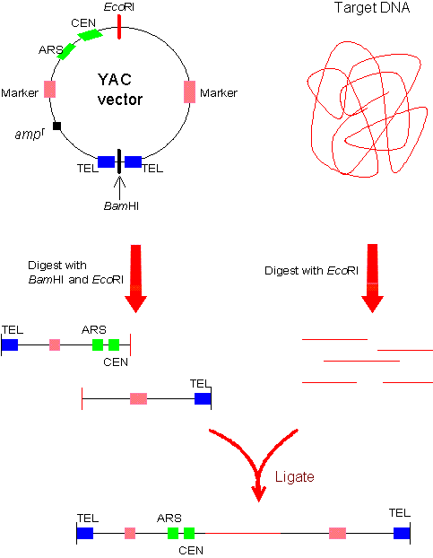
Yeast Artificial Chromosomes
The yeast artificial chromosome (YAC) vector is capable of carrying a large DNA fragment (up to 200 Kb), but its transformation efficiency is very low.

Slide 22


